Slide 1
Online Illegal Content
DIGITAL SERVICE ACT
Camille Degraux, Alexandra Teklak, Stéphan André

Slide 2
TABLE OF CONTENTS
1
CONTEXT
2
PROBLEMS
3
SOLUTION
4
PROCESS & ITS NATURE

Slide 3
1
CONTEXT
E-COM to DSA: a very different online environment

Slide 4
CONTEXT
1.

Slide 5
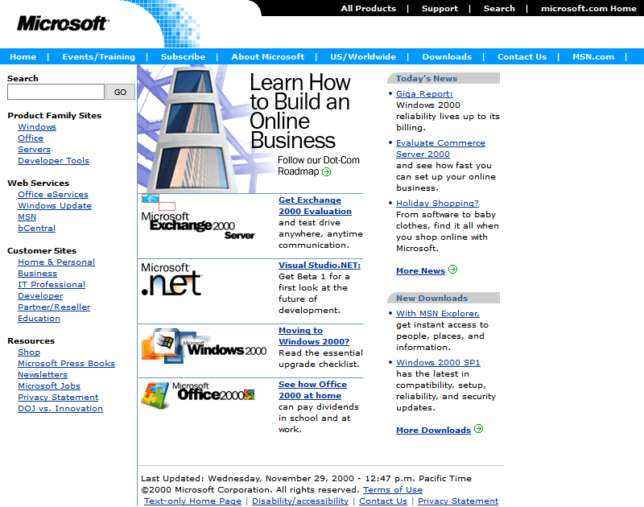
CONTEXT
1.

Slide 6
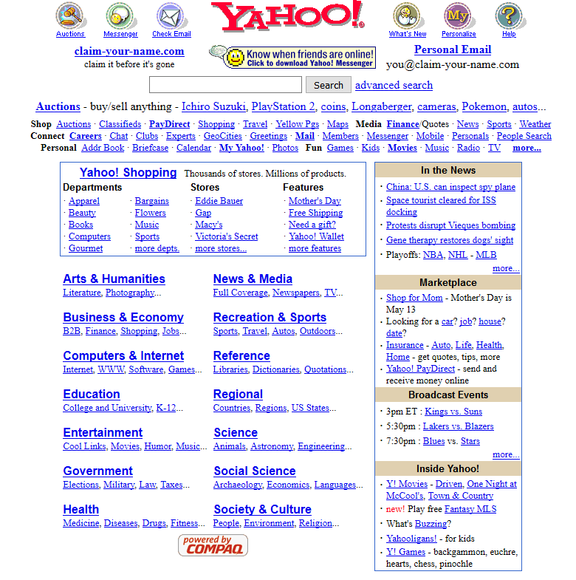
CONTEXT
1.

Slide 7
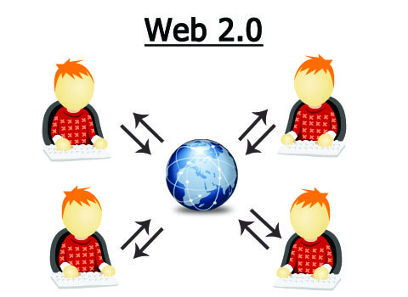
CONTEXT
1.
User interaction
Centralised ecosystems
Extracting economic value from users
Misleading, brutal, harmful content
Illegal content
Illegal goods

Slide 8
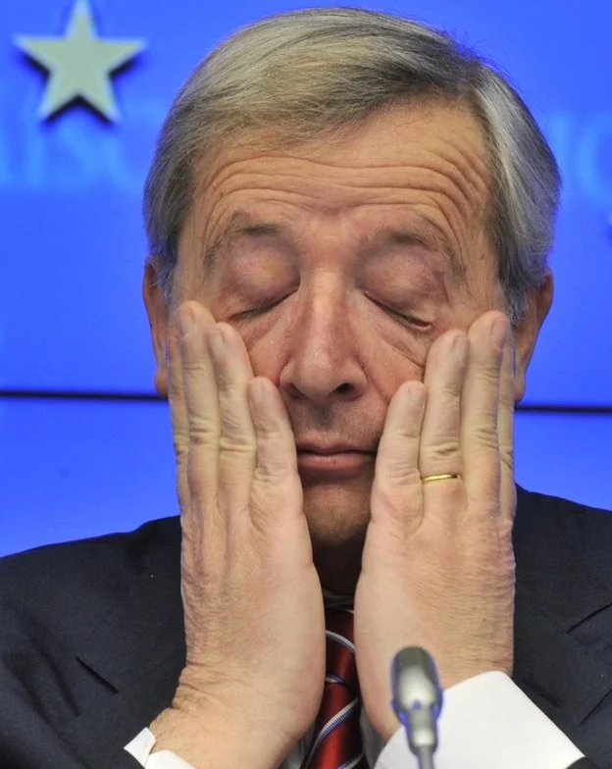
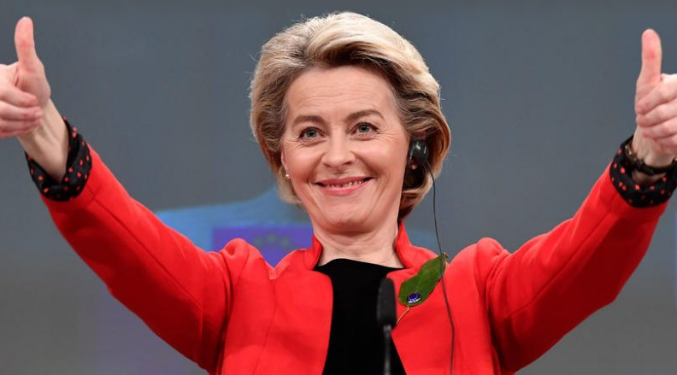
1.
CONTEXT
Commission Recommendation (EU) 2018/334 of 1 March 2018 on measures to effectively tackle illegal content online
Regulation (EU) 2022/2065 […] of 19 October 2022 on a Single Market For Digital Services and amending Directive 2000/31/EC

Slide 9
2
PROBLEMS
There are quite a few

Slide 10
2.
PROBLEMS
Directive 2018/1908
+ Regulation 2019/1150
2015 Internet Forum, 2018 Hate speech guidelines, 2019 consumer protection cooperation
Illegal & harmful content:
Hate speech
Terrorism
Sale of illegal goods
Child pronography
Defamation
Disinformation
Limited scope
No horizontal rules

Slide 11
Powerful online platforms: tracking, profiling, sensitive data usage
2.
PROBLEMS
No harmonised rules across Member States: fragmentation, legal uncertainty
Problematic monitoring algorithms
Lobbying, trilogue and opacity

Slide 12
3
SOLUTION
DSA to the rescue!

Slide 13
3.
SOLUTION
Regulates the obligations of digital services that act as intermediaries in their role of connecting consumers with goods, services, and content.
Goals:
Contribute to the proper functioning of the internal market
Safe online environment
Protecting fundamental rights
Facilitating innovation

Slide 14
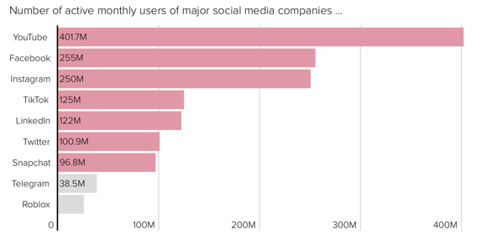
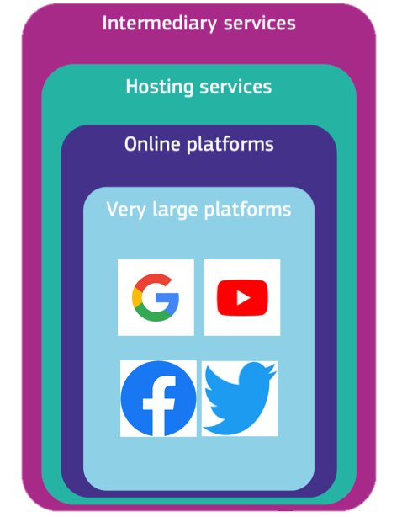
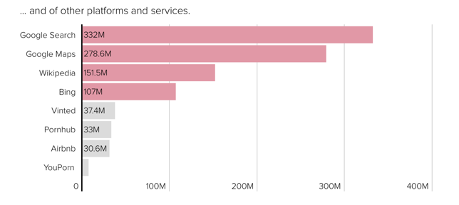
Services
3.
SOLUTION

Slide 15
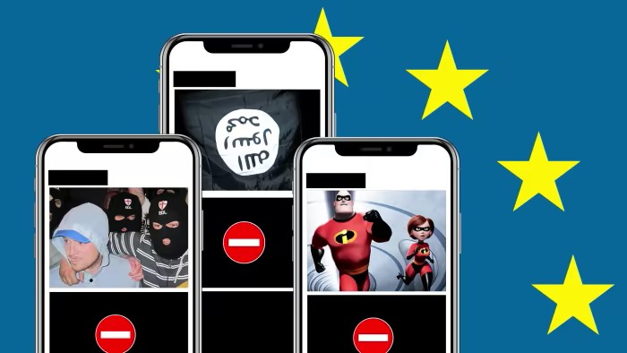
Illegal Content
3.
SOLUTION

Slide 16
Benefits
3.
SOLUTION
Benefits for citizens
Benefits for businesses
Better services:
Identify business users
Trusted flaggers
Reduced compliance costs
& Potential exemptions
Harmonized rights for users:
Notify illegal goods/content
Contest takedown decisions
Recommender systems
More effective flagging tools
Internal & External redress
Transparency on advertising:
Information: What? Why?
≠ Targeted ads for minors
≠ Profiling on sensitive data
E-Commerce liability exemption remains
+ Good Samaritan Principle

Slide 17
Online Platforms & VLOPs
3.
SOLUTION
All intermediaries in scope:
Clearly inform users in their T&C of any restrictions
Act in a proportionate manner in applying any restrictions + due regard to the rights and legitimate interests of the parties, including applicable fundamental rights.
All intermediaries in scope (except for micro-enterprises):
Annual reports on content moderation activities
VLOPs and VLOSEs:
Have to meet risk management obligations
Provide transparency of their recommender systems
Share data with authorities and researchers
Publish transparency reports every six months.

Slide 18
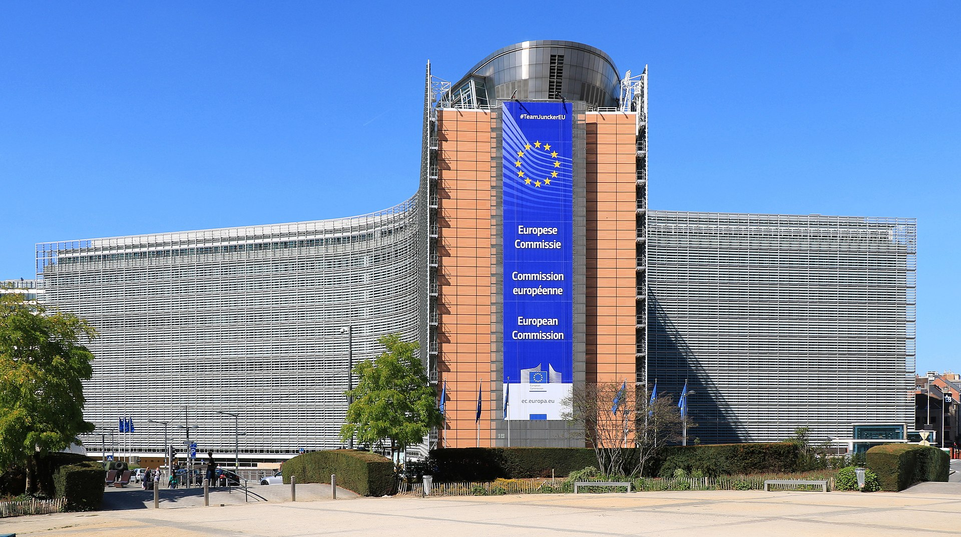
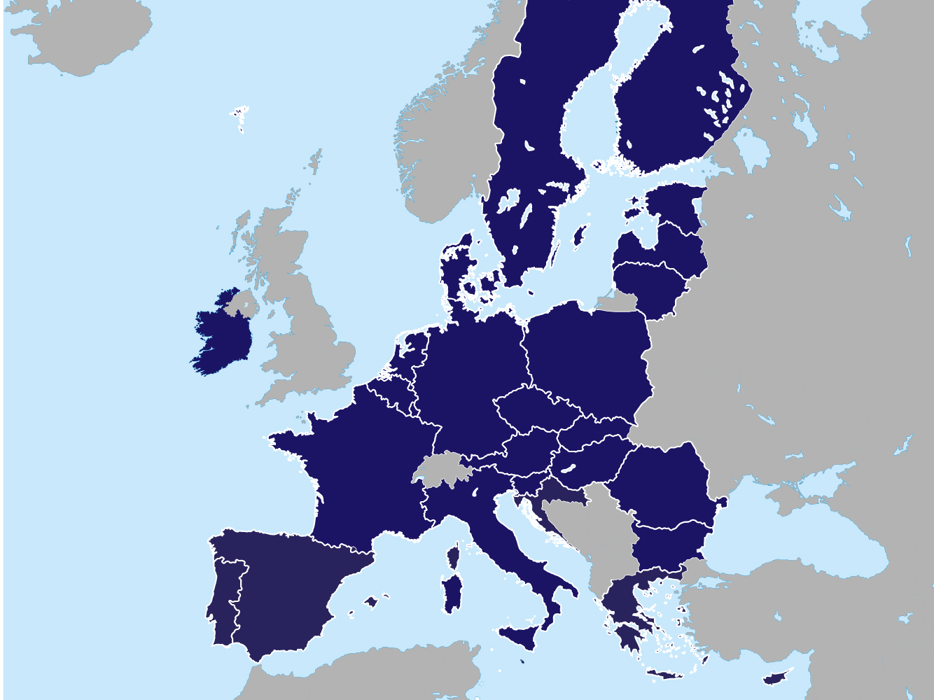
Supervision
3.
SOLUTION
For smaller platforms:
MS will need to appoint a Digital Services Coordinator for supervising and/or for coordinating with sectoral authorities
For VLOPs VLOSEs:
The Commission will have direct supervision and enforcement powers

Slide 19
3.
Sanctions
SOLUTION
Penalties:
DSCs: can impose penalties
MS: specify (proportionate) penalties in their national laws
Fines: up to 6% of the annual worldwide turnover
Require actions:
DSC and Commission: power to require immediate actions when necessary to address very serious harms.
For the platforms refusing to comply with important obligations,
possible temporary suspension of their service.

Slide 20
4
PROCESS & ITS NATURE
The wonder of swift legislative procedure at the EU

Slide 21
4.
PROCESS & ITS NATURE
Parliament resolutions:
Transparency, accountability & obligations
Plan, consultation
Parliament & Council Adoption process
February 2020
October 2020
Commission proposal:
Based on 114 TFEU
Trilogue
December 2020
19th October 2022

Slide 22
THANK YOU!

